Slide 1

The Battle of Neighborhoods
Italian Restaurant Recommendations

Slide 2
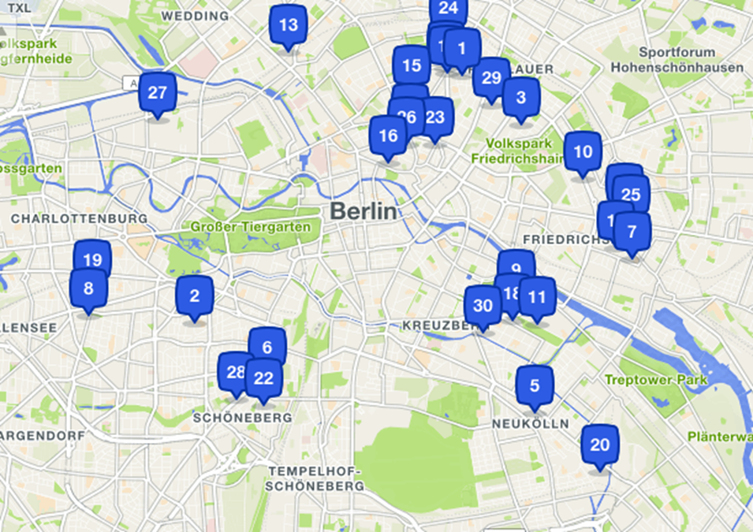
Business question: Where in berlin can we put a new Italian restaurant?

Slide 3
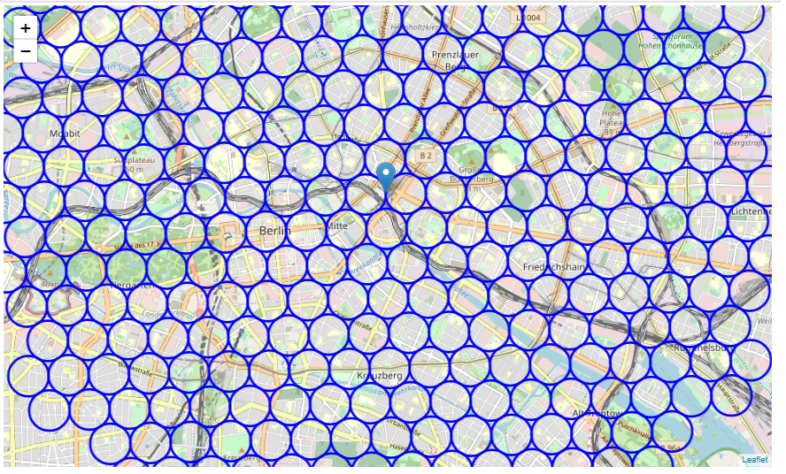
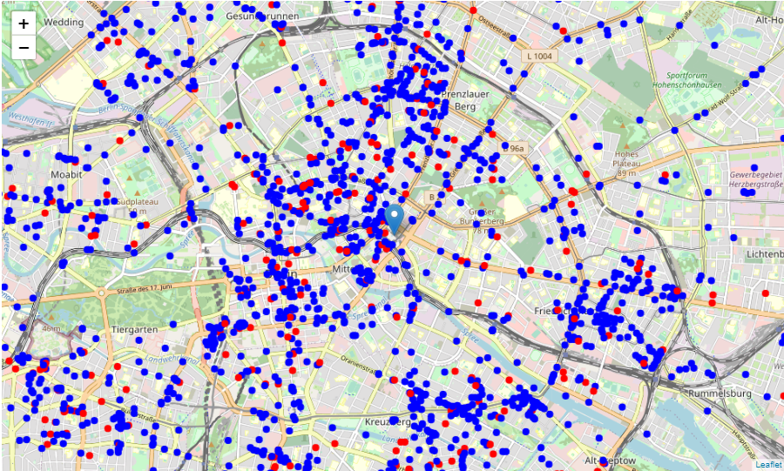
Research and Methodology:
Berlin has a large geographical area that had to be sectioned into smaller areas and then plotted for restaurants.
Once plotted, a second plotting for Italian and non-Italian was done to provide a visual.
Analysis showed that lowest concentration in areas south, south-east and east Berlin.
A deep dive was done on into the 15 “zones” in this area to provide a recommendation.

Slide 4
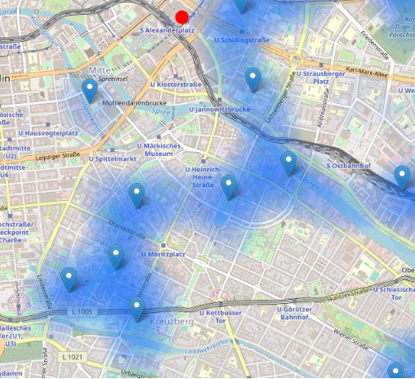
Recommendation From these 15 “zones” I created to review. Lowest overall concentration level was determined to be south of Alexanderplatz.

Slide 5
Conclusion
Purpose of this project was to identify Berlin areas close to center with low number of restaurants (particularly Italian restaurants) in order to aid stakeholders in narrowing down the search for optimal location for a new Italian restaurant.
By calculating restaurant density distribution from Foursquare data I was able to focus in on the area south and southeast and discover that there is an opportunity to open an Italian restaurant near Alexanderplatz.

